Slide 1
AI and Speech
From Early Synthesis to Modern TTS
Ross Reedstrom - AI and Speech

Slide 2
AI & Speech: Overview
Why Speech?
ML and speech:
  Speaker recognition
  Transcription
  Voice command
  Text to speech
Today: history → ecosystems → Piper retraining

Slide 3
History of Speech Synthesis
Ross Reedstrom - AI and Speech

Slide 4
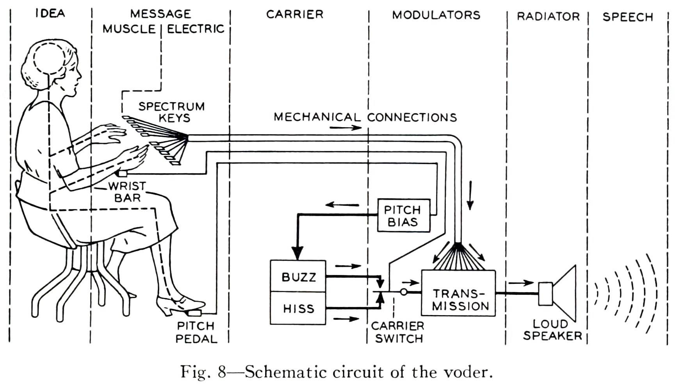
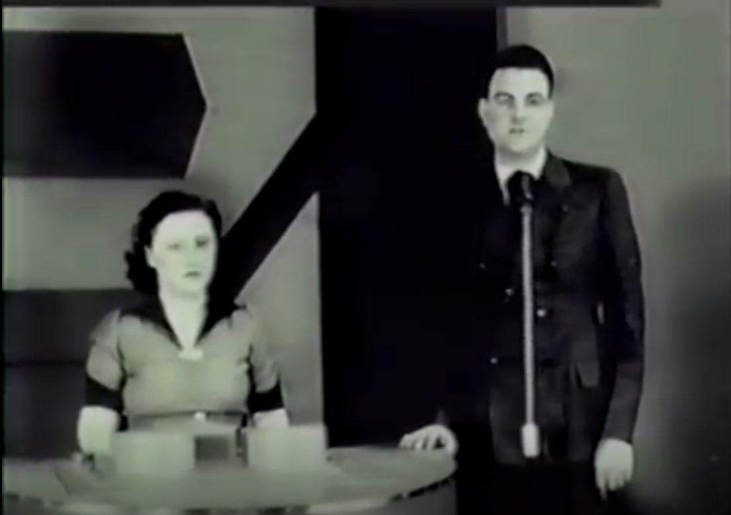
1939 Voder
First publicly demonstrated speech synthesizer
Voder in action
Ross Reedstrom - Text to Speech

Slide 5
HMM Era (1970s–2010s)
• Hidden Markov Models for speech recognition and parametric TTS
• GMMs model acoustic frames
• Foundation for statistical sequence modeling

Slide 6
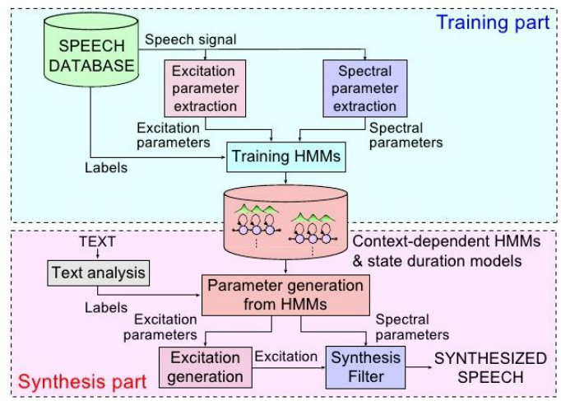

Concatenative & HTS
Hidden Markov Models - HMM Text to Speech
Parametric and Concatenative unit‑selection 1990s–2000s
Ross Reedstrom - Text to Speech

Slide 7
Deep Learning Era (2010–present)
CNN/RNN/Transformer ASR
WaveNet
Tacotron
VITS

Slide 8
Neural Text‑to‑Speech
WaveNet - autoregressive generative audio
Tacotron - neural text‑to‑mel + vocoder architectures
VITS - conditional variational autoencoder with adversarial training
Ross Reedstrom - Text to Speech

Slide 9
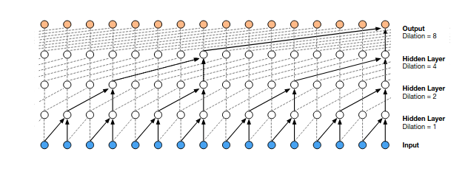
WaveNet
A CNN with special features for dealing with temporal data, i.e. audio (waveform)
https://deepmind.google/blog/wavenet-a-generative-model-for-raw-audio/
https://arxiv.org/pdf/1609.03499 (2016)
Ross Reedstrom - Text to Speech

Slide 10
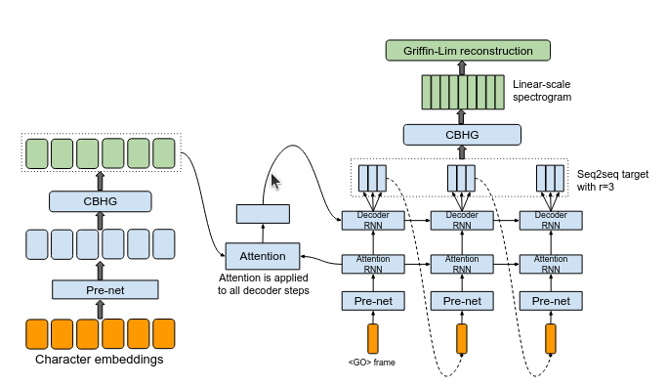
Tacotron / Tacotron 2
A seq2seq NN with attention
T2: change out the target generation and vocoder (wavenet)
https://arxiv.org/pdf/1703.10135 (2017) https://arxiv.org/pdf/1712.05884 (2018)
https://google.github.io/tacotron/publications/tacotron2/index.html
Ross Reedstrom - Text to Speech

Slide 11
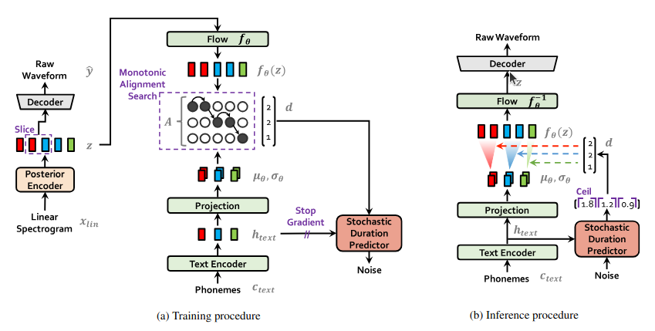
VITS
Variational inference + normalizing flows + GAN
Fast, lightweight inference (ONNX)
VITS samples https://jaywalnut310.github.io/vits/ https://arxiv.org/pdf/2106.06103 (2021)
Ross Reedstrom - Text to Speech

Slide 12

Piper Overview
An implementation of VITS targeting self hosting and home automation systems
Piper repo → https://github.com/OHF-Voice/piper1-gpl
Sample voices → https://rhasspy.github.io/piper-samples/
Ross Reedstrom - Text to Speech

Slide 13
An Aside
TTS is a small fraction of AI work in speech, let alone audio. Many speech as input uses:
Automated Speech Recognition
Speaker modeling
Voice commands

Slide 14
ASR: Speech Recognition
HMM-GMM → CTC → Transformers (Whisper, wav2vec2)
Applications: captioning, dictation, translation

Slide 15
Speaker Modeling
Identification (closed set) vs verification (metric learning)
Embeddings: i‑vector, x‑vector, ECAPA‑TDNN

Slide 16
Wake Words & Voice Commands
Keyword spotting on microcontrollers (OpenWakeWord)
Small CNN/CRNN models
Intent detection pipelines

Slide 17
Piper & Voice Retraining
Ross Reedstrom - Text to Speech

Slide 18
Piper Retraining Workflow
Dataset → alignment → mel targets
Speaker embedding selection (e.g., ECAPA similarity, best guess)
Fine‑tuning VITS components
Export ONNX for deployment

Slide 19
Datasets
Samples of speech with transcripts (“utterances”)
Need to be short (3-10 sec)
Accurate transcripts
High quality records, with little or no background noise
We can provide one
Create your own - Piper Recording Studio
Published audio with transcripts (cut down - be careful about licenses)

Slide 20
The training notebook
piper_train.ipynb

